Slide 1
Software Defined Networking (SDN)
Week 8

Slide 2
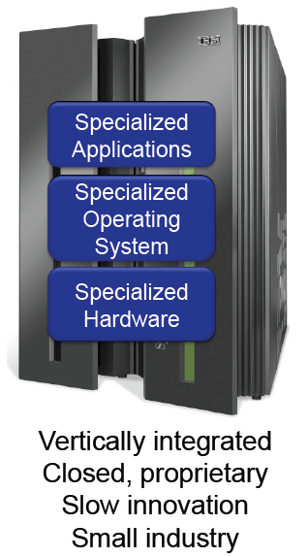
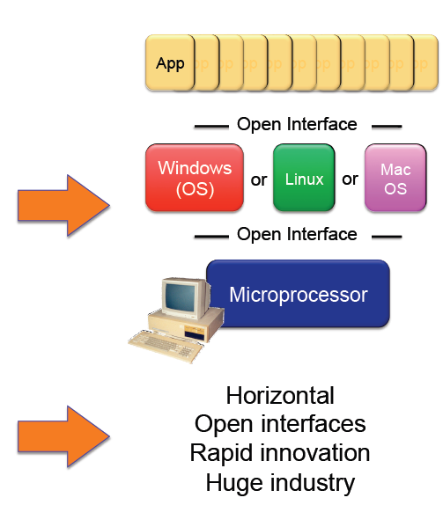
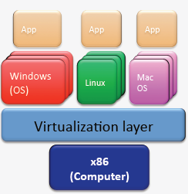




Traditional Computing Vs Modern Computing

Slide 3




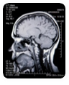

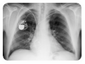





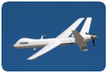








Big Data: Fueling Smarter Commerce Cycle
Safety / Security
High
Exa
10s millions cameras
Peta
Video
Healthcare
Data Volume
Sophistication of Analysis
Computational Needs
Med
Tera
Image
1B medical images/yr
Customer
Audio
Giga
Text
Structured data
1990’s
2000’s
2010’s
2020’s
Low
1B camera phones
Media
Wide Area Imagery
Digital Marketing
Enterprise Video
72 video hrs/minute
100’s TB per day
10+% of video views
Used by 1/3 of enterprises
Notes:
Casimer
3

Slide 4
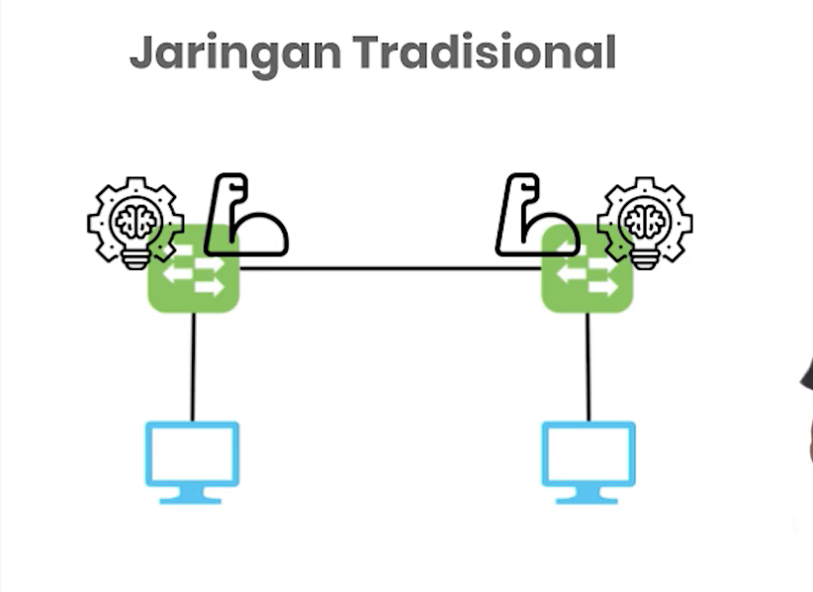






Slide 5
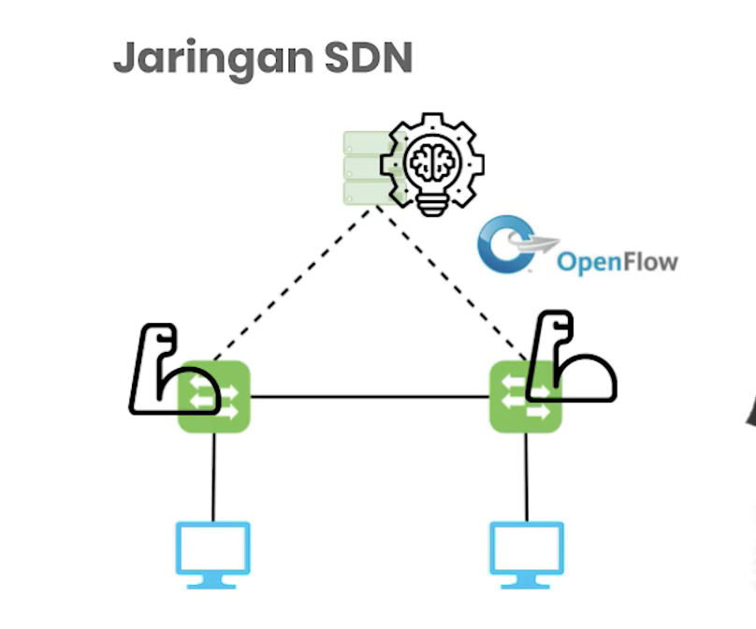
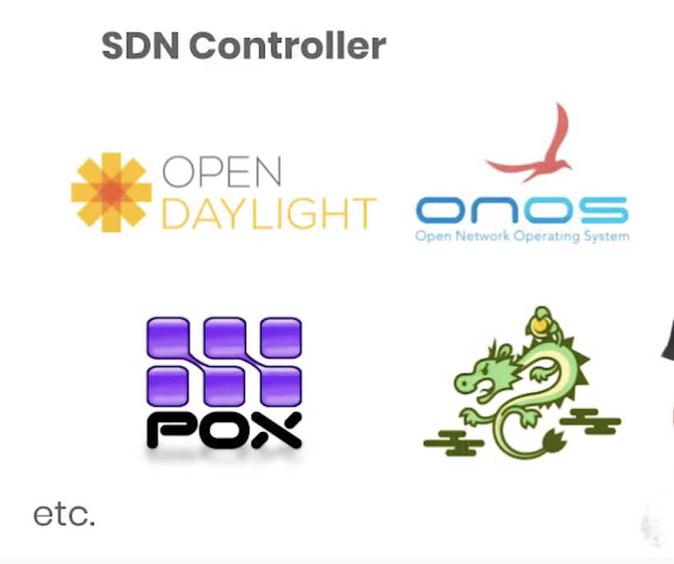






Slide 6
Limitations of Current Networks
Enterprise networks are difficult to manage
“New control requirements have arisen”:
Greater scale
Migration of VMM
How to easily configure huge networks?
Notes:
validate responsiveness as demand varies according to user needs
firewalls and load balancers
eliminate vulnerability and exposure between users and applications

Slide 7
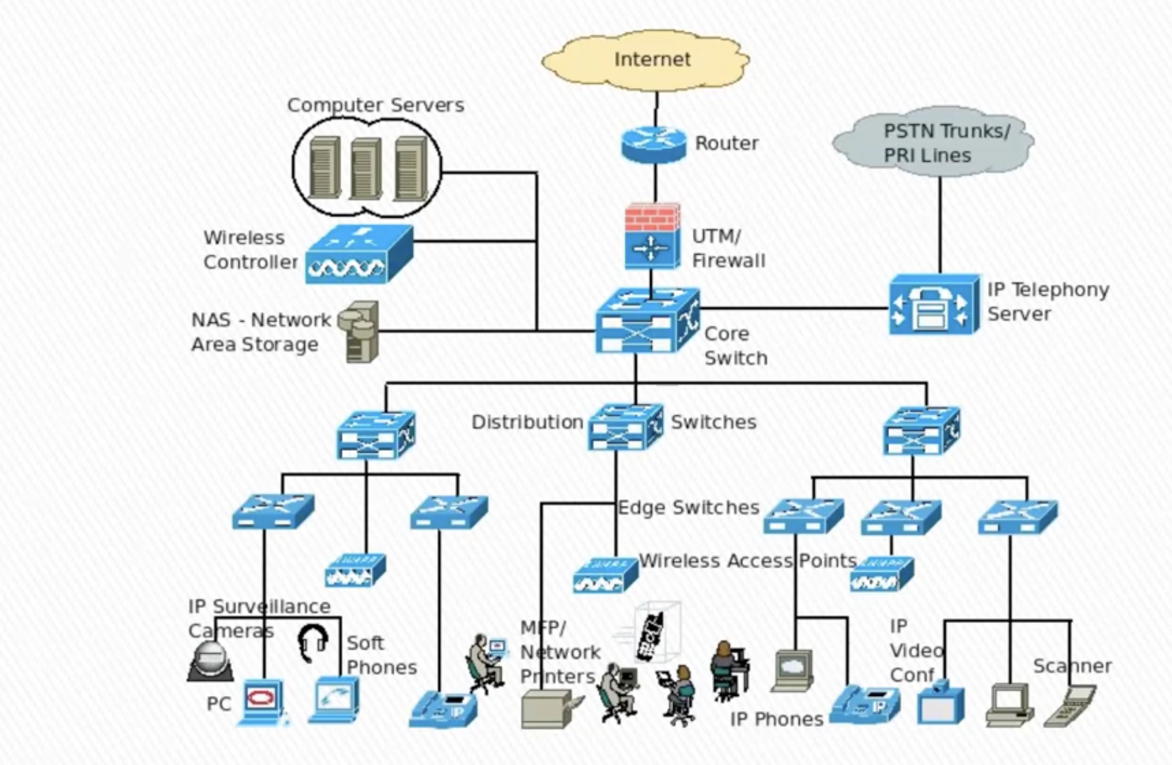
















Slide 8
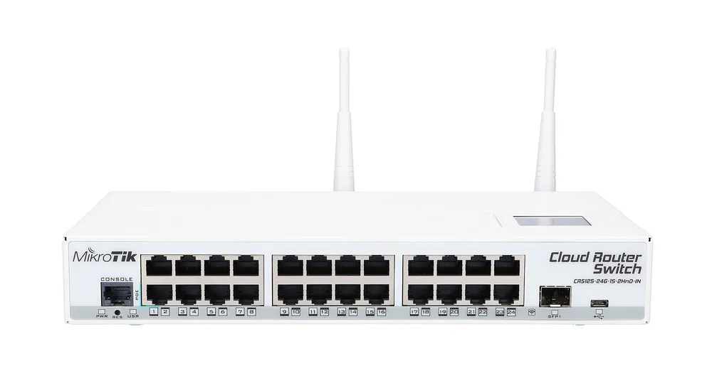
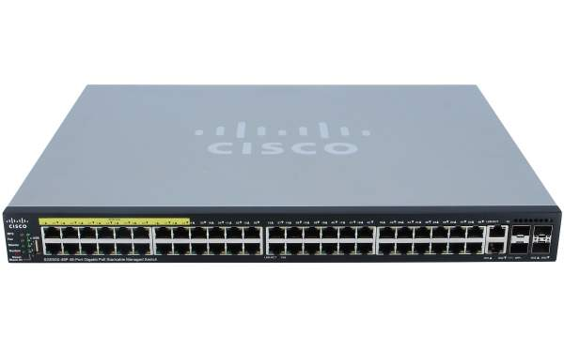
Switch Technology

Slide 9
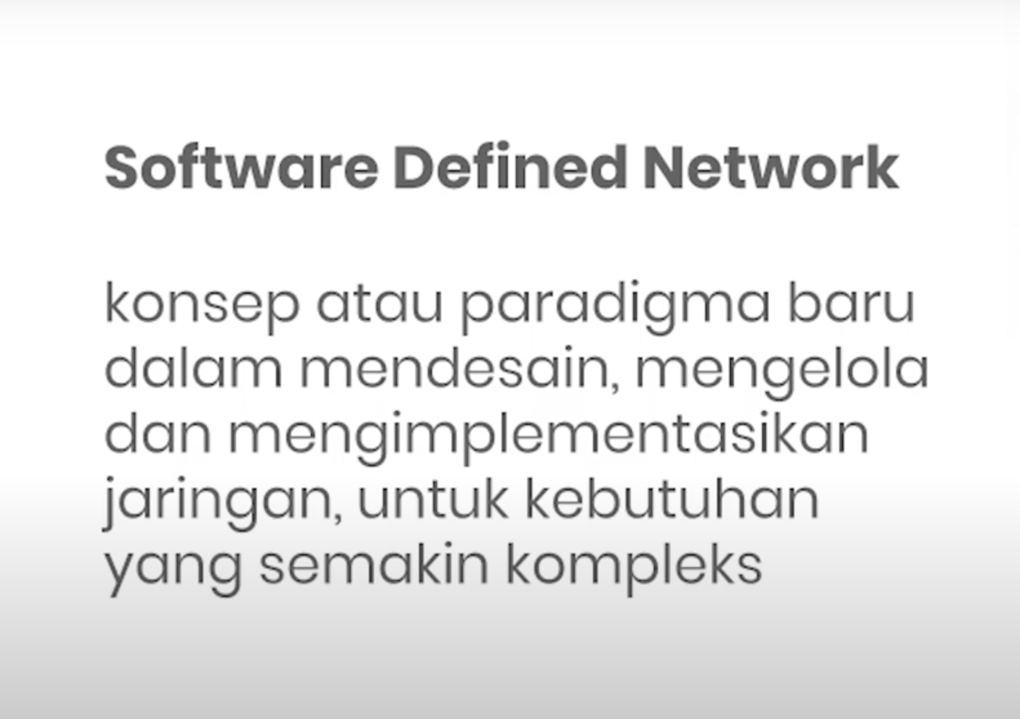

Slide 10
Software-defined Networking (SDN)
It is an approach to computer networking that allows network administrators to programmatically initialize, control, change, and manage network behavior dynamically via:
open interfaces
abstraction of lower-level functionality
SDN is meant to address the fact that the static architecture of traditional networks doesn't support the dynamic, scalable computing and storage needs of more modern computing environments such as data centers.

Slide 11
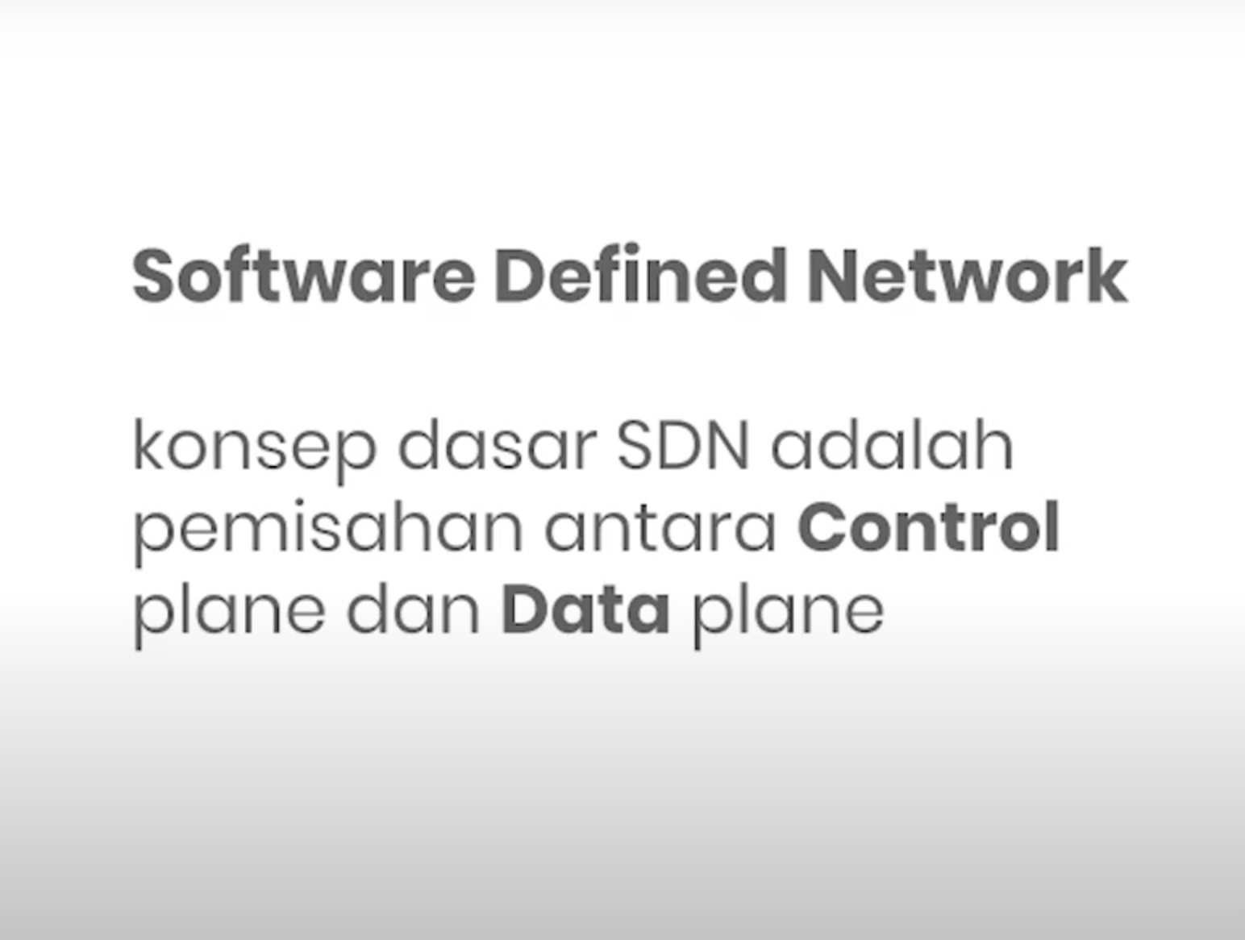

Slide 12
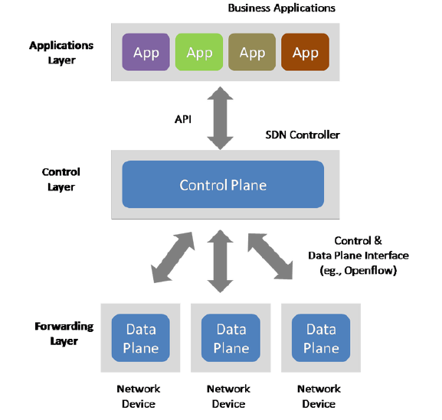






Slide 13




What is SDN?
SDN Definition
Centralization of control of the network via the
Separation of control logic to off-device compute, that
Enables automation and orchestration of network services via
Open programmatic interfaces
SDN Benefits
Efficiency: optimize existing applications, services, and infrastructure
Scale: rapidly grow existing applications and services
Innovation: create and deliver new types of applications and services and business models

Slide 14
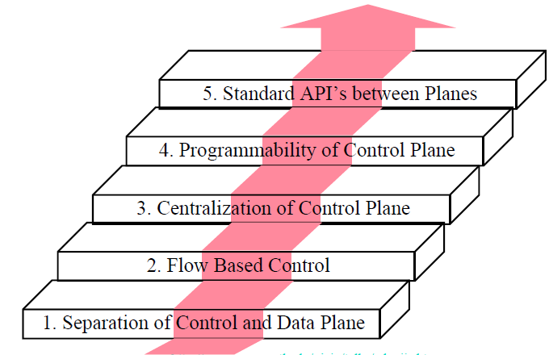
SDN Innovation & Components
App
App
App
App
Well-defined Open API
SDN Controller/ Network Operating System
OpenFlow
OpenFlow compliant OS
Packet-Forwarding Hardware
OpenFlow compliant OS
OpenFlow compliant OS
Packet-Forwarding Hardware
Packet-Forwarding Hardware

Slide 15
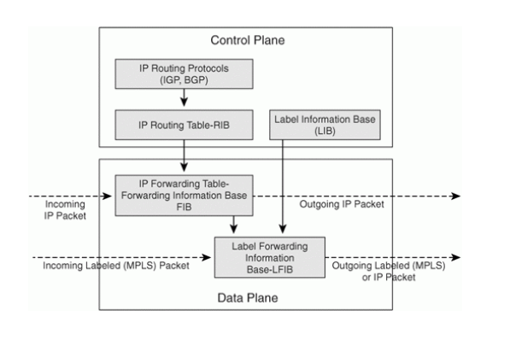
Traditional Networks

Slide 16
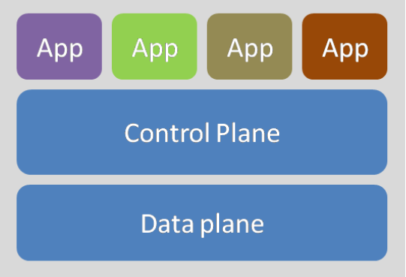

Slide 17
The SDN architecture is:
Directly programmable: Network control is directly programmable because it is decoupled from forwarding functions.
Agile: Abstracting control from forwarding lets administrators dynamically adjust network-wide traffic flow to meet changing needs.
Centrally managed: Network intelligence is (logically) centralized in software-based SDN controllers that maintain a global view of the network, which appears to applications and policy engines as a single, logical switch.
Programmatically configured: SDN lets network managers configure, manage, secure, and optimize network resources very quickly via dynamic, automated SDN programs, which they can write themselves because the programs do not depend on proprietary software.
Open standards-based and vendor-neutral: When implemented through open standards, SDN simplifies network design and operation because instructions are provided by SDN controllers instead of multiple, vendor-specific devices and protocols.

Slide 18
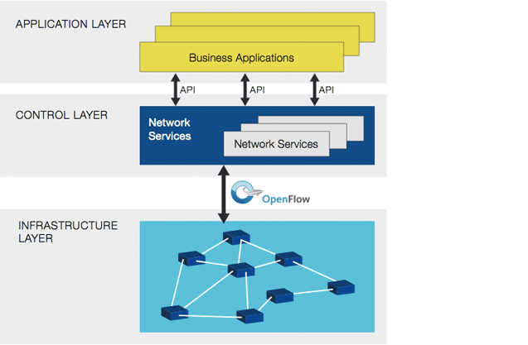

Slide 19
Traditional vs. SDN networks
Point of Difference | Traditional Networks | Software-Defined Network
Dynamics | Today’s business environment expects zero service disruption — this means networks must dynamically adapt to changing traffic by anticipating user demands. With traditional networks becoming increasingly complex, it is an uphill task to match market demands. | By placing the control logic outside of the network hardware, businesses have more flexibility to control programmability, automation etc. This helps them develop scalable networks that adapt to changing business needs in quick time.
Application of Policies and Security | Implementing a network-wide policy requires configuring at the device-level, making it difficult to apply a consistent set of access, security, QoS, and other policies in today’s mobile environment. This leaves the enterprise open to security breaches, non-compliance with regulations, and so on. | SDN by contrast allows network operators to programmatically configure a simplified network abstraction ensuring higher chances of a consistent application of policies, security etc. across the entire network.
Scalability | It is a challenge for the network to keep pace with growing demands on the data center. Typically, link oversubscription has allowed scaling of the network by estimating traffic patterns – this however, is not a reliable method anymore. | With SDN, since it is possible to abstract the underlying infrastructure, network manageability, scalability, and agility can be enhanced.
Control of Network Devices | In the current scenario, enterprises are constrained by vendors equipment product cycles and hence are unable to respond quickly to business demands. Lack of standard and open interfaces hinders customizing the network to individual environments. | SDN control software is vendor-agnostic and can control any network device. To ensure faster responses to changes, SDN-based orchestration and management tools can help quickly deploy, configure, and update devices across the entire network.

Slide 20
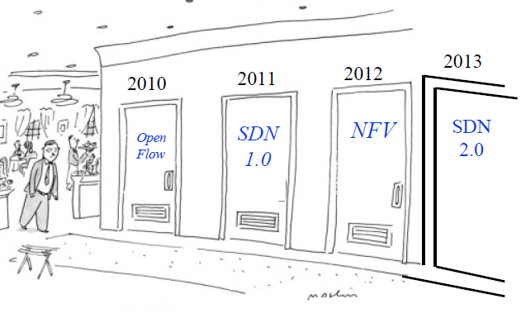
OpenFlow, SDN, NFV Evolution

Slide 21
What is Open Flow
OpenFlow is like an x86 instruction set for the network nodes.
Provides open interface to “black box” networking node (ie. Routers, L2/L3 switch) to enable visibility and openness in network
Separation of control plane and data plane.
The datapath of an OpenFlow Switch consists of a Flow Table, and an action associated with each flow entry
The control path consists of a controller which programs the flow entry in the flow table

Slide 22
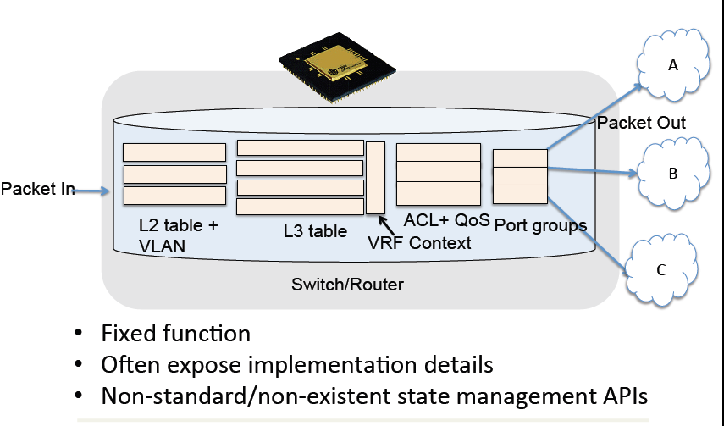


Traditional Switch Forwarding
Notes:
Kasado

Slide 23
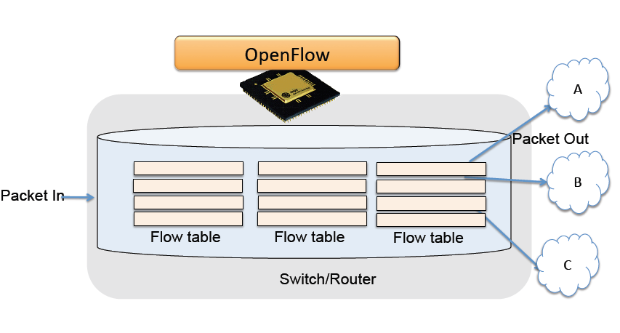

Open Flow Switch Forwarding
Notes:
Kasado

Slide 24
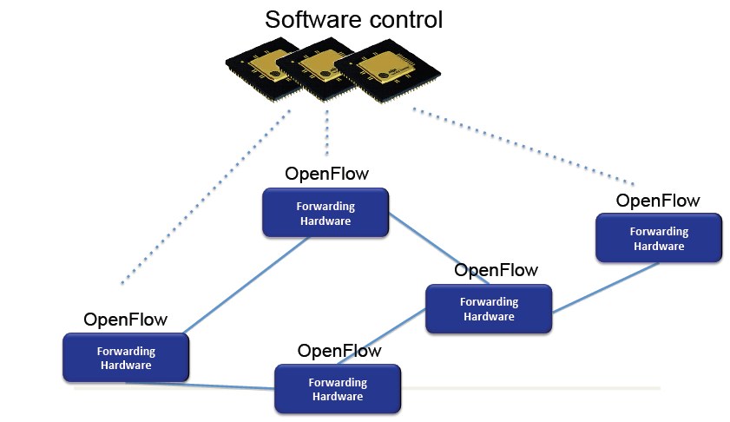


Open Flow Illustration

Slide 25
Open Flow
General Myth
SDN is Open Flow
Reality
OpenFlow is an open API that provides a standard interface for programming the data plane switches

Slide 26
Summary
Software Defined Network (SDN) adalah sebuah paradigma baru dalam mendesain, mengelola, dan mengimplementasikan jaringan, terutama untuk mendukung kebutuhan inovasi dibidang jaringan yang semakin lama semakin kompleks.
Konsep dasar SDN adalah melakukan pemisahan antara control dan forwarding plane/data plane. Dengan menggunakan konsep SDN, sebuah infrastruktur dapat dikelola/dimanajemen dengan mudah, dikarenakan adanya controller yang mengatur setiap router dengan protokol Openflow [7].

Slide 27
Summary
SDN memiliki tanggung jawab dalam mengatur control plane, mulai dari mendeteksi perangkat jaringan yang akan diteruskan sampai kepada memanajemen perangkat jaringan secara terpusat dengan menggunakan software melalui abstraksi dan pandangan yang luas kepada seluruh jaringan [8].

